Slide 1
Time Series Forecasting

Slide 2
Steps
A time series dataset has the following four components such as Trend, Cyclic, Seasonality and Randomness.
Decompose the given dataset
Additive decomposition
Multiplicative decomposition
(i) Additive will have linear trend,
(ii) If there is changes to width or height in every season then it is multiplicative.

Slide 3
Steps
2. Visualize the decomposed dataset for the following pattern
Inc /dec trend
Seasonal
Random (Remainder)

Slide 4
Steps
3. Stationarize the dataset
(i) Check for unequal variances in the data set (Using log)
(ii) Stationarity check (Augmented Dickey-Fuller Test) – ADF Test
(iii) If stationarity doesnot exist Stationarize by Differencing (Y_{t} - Y_{t-1})
4. Plot ACF and PACF

Slide 5
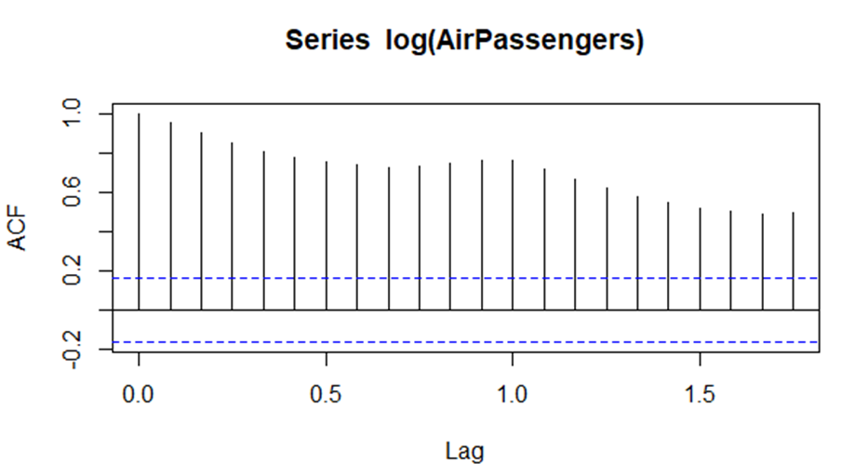
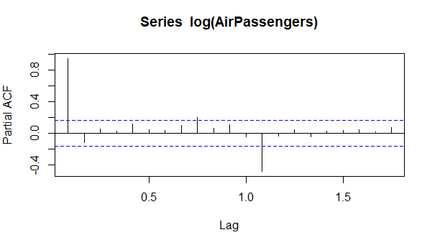

Slide 6
Steps
5. Build ARIMA model
6. Make predictions

Slide 7
LAB EXERCISE 4
Store Airpassengers dataset (inbuilt dataset available in ‘R’) in a dataframe named “data”, install packages such as ‘forecast’, ‘tseries’. Perform the following
Display entire dataset
Check for unfilled data
(ii) Display the statistical info of the dataset such as min, max, 1st quartile, 3rd quartile, mean and median.
(iii) Plot ‘data’ (No. of Air passengers Vs Year)
(iv) Plot as timeseries ‘data’ (monthwise)
(v) Decompose the data as multiplicative and store as ‘ddata’
(vi) Plot ‘ddata’
(vii) Plot the following: trend, seasonal and random separately.
(viii) Perform ADF test for stationarity
(ix) Plot ACF and PACF
(x) Model using ARIMA

